Slide 1

A study of the factors affecting enrollment in USA universitie
By Nouf Al-ruhaili, Maram Al-shehri, Nourah Al-saadan

Slide 2
Contents
1- Introduction
2- Map diagram
3- Trend analysis
4- Bar chart
5- Combination chart
6- Dashboard

Slide 3
Introduction
Our data:
The dataset contains information the top 100 universities in the U.S. with their rankings, tuition cost, and the number of undergraduate enrolments in 2017.
Our goals:
1/ finding out if the tuition cost is an obstacle for undergraduate students to enroll in the top-ranking universities
2/figuring out if there is a relationship between the number of undergraduate enrolments and higher-ranking universities

Slide 4
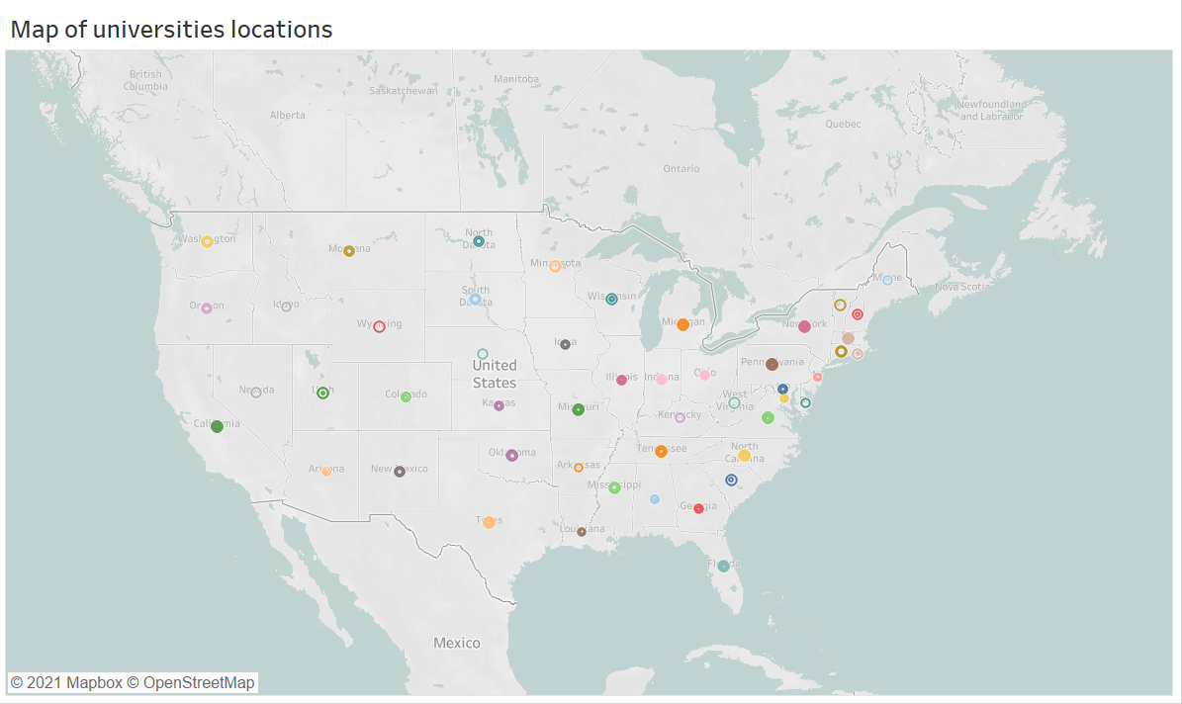
Map Diagram | Universities in each state

Slide 5
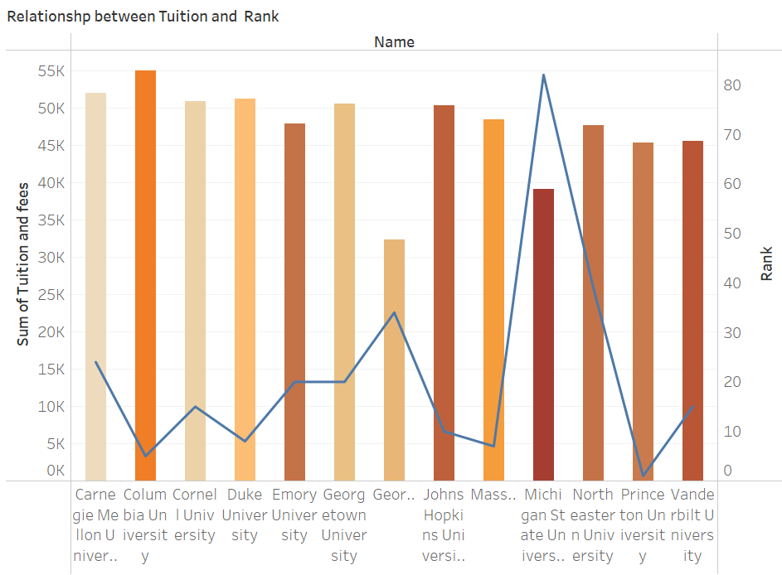
Combination Chart | Relationship between tuition and rank

Slide 6
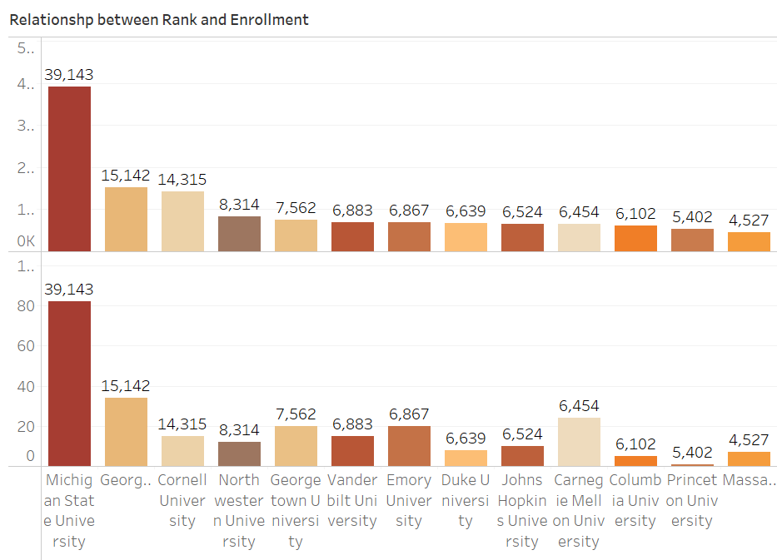
Bar Chart | Relationship between the rank and enrollment

Slide 7
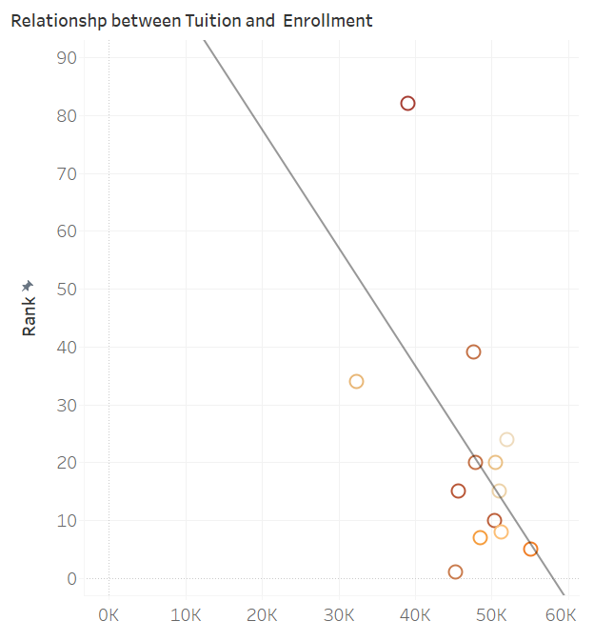
Trend Analysis | Relationship between tuition and enrollment

Slide 8
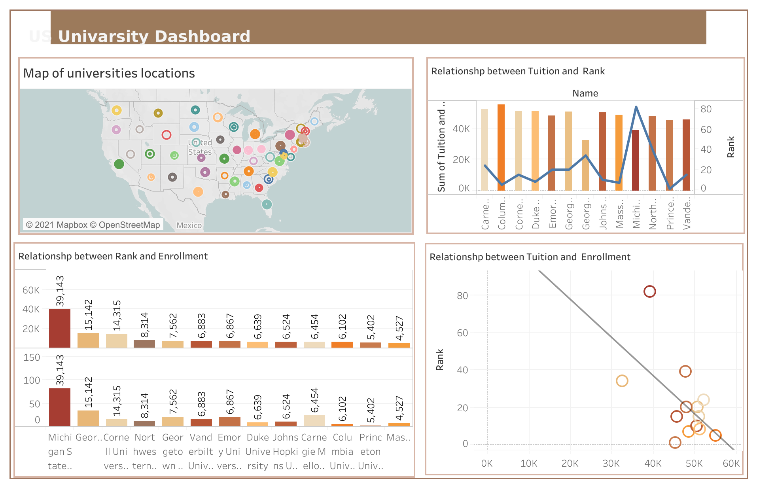
Universities dashboard

Slide 9

Thanks for your attention
Any Questions ?

